Slide 1

St. Petersburg 20th November 2017
A holistic approach to addiction and mental health problems for women in prison
Addiction problems comes along with mental health and social problems.
You have to address the whole person to succeed.
Andreas Skulberg
Deputy Director General
Ministry of Justice and Public Security

Slide 2
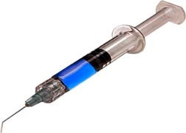

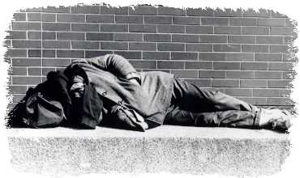


What are the problems?
Addiction
Family in prison
Low education
Unemployment
Chronic illnesses
Homeless
Child protection board
Below povertyline
INMATES’ LIVING CONDITIONS
60 %
30 %
40 %
80 %
50 %
70 %
30 %
40 %
Notes:
Det er altfor mange som har lite å gå til når dommen er sonet. Undersøkelser av levekårene for de som kommer i fengsel, viser langt større problemer enn det vi finner i befolkningen ellers.
(Problemlisten i beredskap til spørsmål)
60 % rusmisbrukere
30 % opplevd familie i fengsel
40 % maks. ungdomsskole
30 % arbeidsledige
50 % kroniske sykdommer
30 % barnevernsklienter
30 % bostedsløse
40 % under fattigdomsgrensen)
Det er en sammenheng mellom kriminalpolitikk og velferdspolitikk. Bedre levekår er viktig for å få ned gjengangerkriminaliteten. Det er derfor regjeringen i Soria Moria-erklæringen la frem tanken om en tilbakeføringsgaranti.

Slide 3
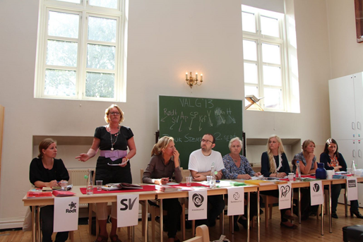
Philosophy
Prisoners have an equal right to education, work, health care and culture. They have the same right to receive help, services, and support from society –according to need.
Prisoners are still members of society.
Prisoners are sentenced to lose their freedom, not their dignity.

Slide 4
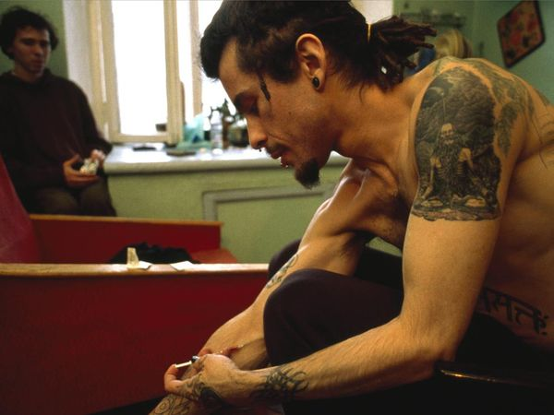
Norwegian Corrections Addiction Strategy
Goal: The convict shall have better control over the addiction problems when she/he leaves corrections
Improve rehabilitation/control that facilitates rehabilitation
Treatment shall be offfered to continue after release
Many people can serve their sentence inside a health care institution instead of in a prison
Notes:
4

Slide 5
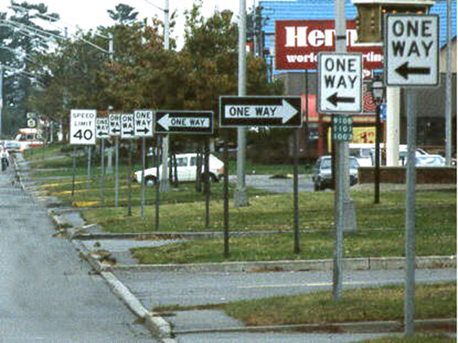
Legislative status:
Addiction - crime or disease?
Change in paradigm?
Use and possesion (user-dosages) of narcotic drugs is illegal, but not punishable for beginners – conditional discharge
First time users: warning from the police, contact with health care system, urine tests for some months
Smugling/selling big quantities – harsh sentences
Heavy users: drug court, treatment
Norway is not ready for the paradigm shift yet…..

Slide 6
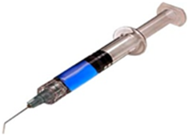
Drug courts
Suspended sentence with the condition to attend a drug treatment and rehabilitation program supervised by the court
Usually 2 years duration.
Drug court team: coordinator, psychologist, social worker, educational adviser, probation officer all located at the same place.

Slide 7

Drug court 4 phases
1. implementation-phase
2. stabilisation-phase
3. responsibility-phase
4. the last phase will focus on getting on with normal lives
The phases will last as long as they have to, different from person to person. The whole program is adjusted very individually.

Slide 8
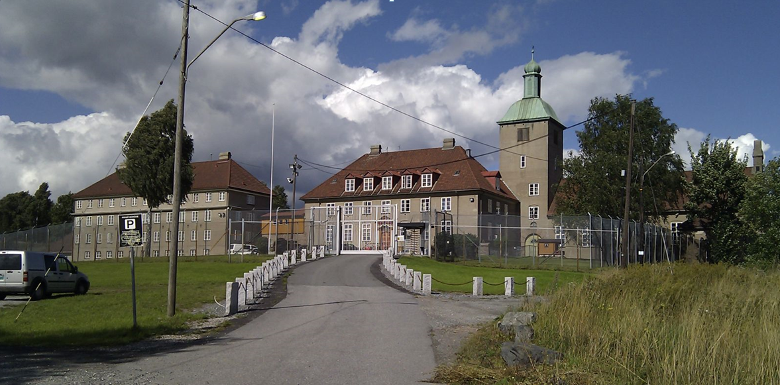
Bredtveit high security prison for women

Slide 9
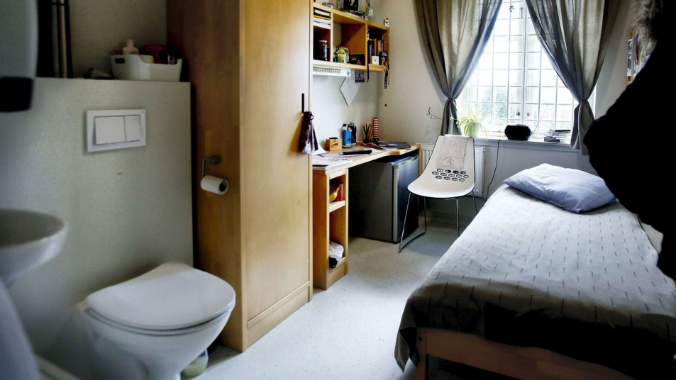
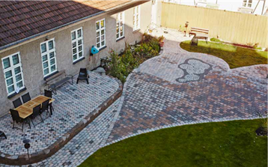
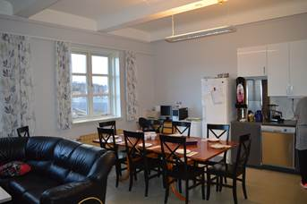

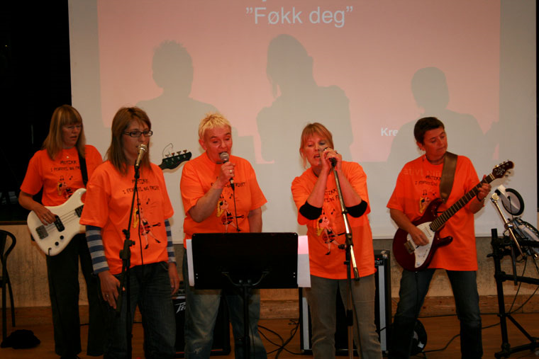
Bredtveit high security

Slide 10
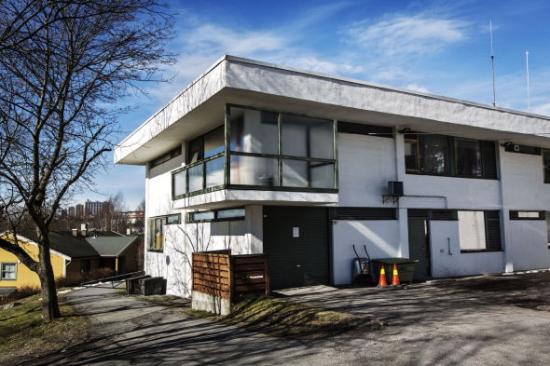
Bredtveit low security prison for women

Slide 11
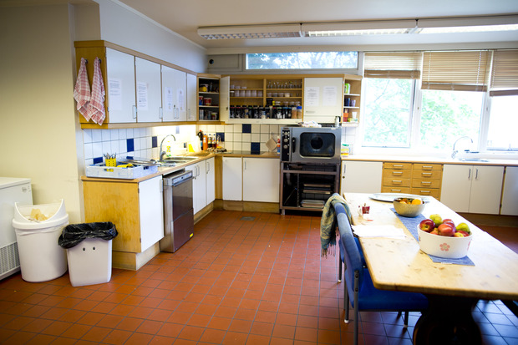
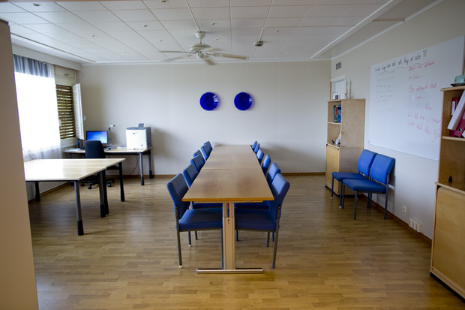
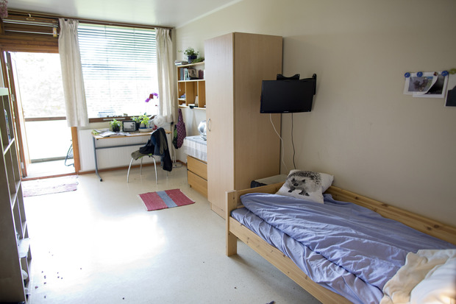

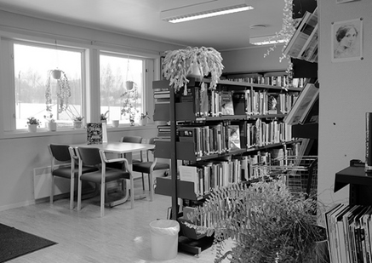
Bredtveit low security

Slide 12
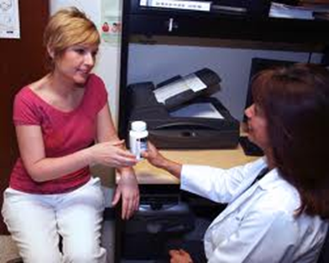
Treating Drug Addiction in Prison
    Addiction teams in all prisons
    Drug Addiction Management Units
    Aiming at prisoners motivated to increase their control of addiction
    Psycologists/psychiatrist, social workers and prison officers work together
    Therapeutic society

Slide 13
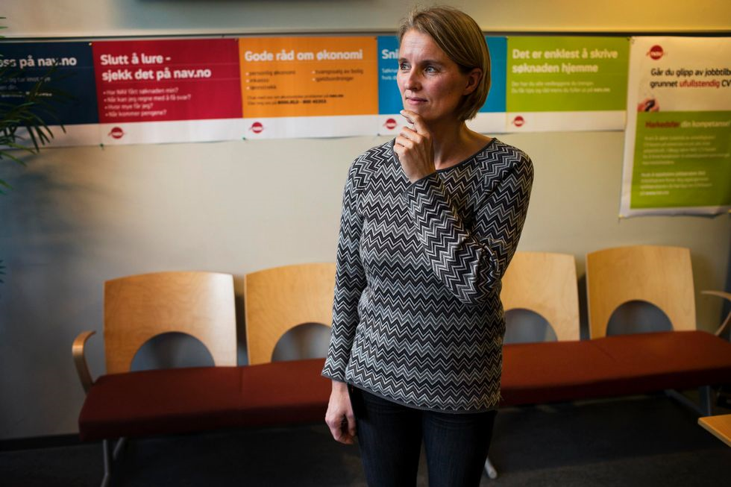
Coordinating help
Treatment for addiction and mental health problems
Education/working skills
Safe place to live
Financial advise
Family/networking
Establish offer of therapy after release
Control

Slide 14
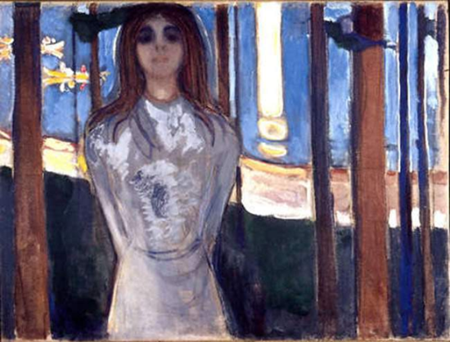
When they use drugs inside the prison -reactions that helps rehabilitation
Realise they use far less drugs in prisons than outside. When they use it, it can be a golden opportunity to start our work!
Urine-tests, breath-tests
Instead of taking away goods, use ”addiction talks”, contracts, motivation
Make responsible and aware instead of punish

Slide 15
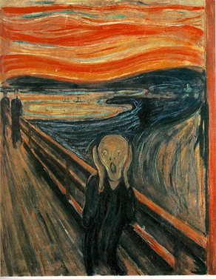
What is ”addiction talk” not?
An informal talk during coffe
It is not treatment
It is not blaming or moralising
Not personal support follow up
Not an interrogation
Notes:
15
Nå vet vi noe om hva en russamtale ikke skal være, men hva er russamtalen?
Russamtalen er først og fremst en alternativ reaksjon på rusmisbruk i fengsel, men skal også være en samtale som motiverer til endring.

Slide 16
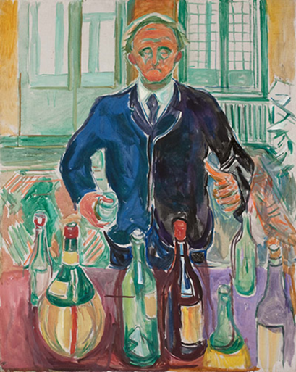
What is ”addiction talk”?
An reaction when convicted persons use drugs or alcohol during executing a sentence
Use of Motivational interviewing and Building of self confidence
Three talks that should end up in higher motivation to get better grip of the addiction
All relevant staff are trained in the methods
Notes:
16
Nå vet vi noe om hva en russamtale ikke skal være, men hva er russamtalen?
Russamtalen er først og fremst en alternativ reaksjon på rusmisbruk i fengsel, men skal også være en samtale som motiverer til endring.

Slide 17
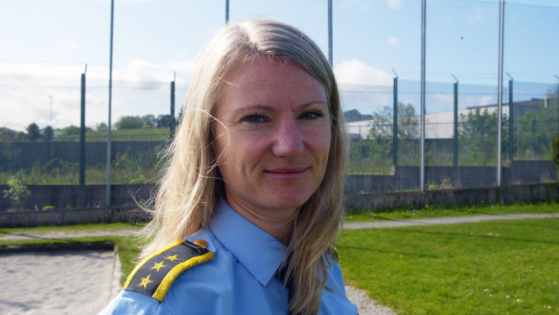
VINN a motivational program
The "VINN program“ consists of 15 topics, four individual interviews as well as homework exercises.
The goal of the program is to motivate the women to explore what challenges are worthwhile to engage in, what makes sense to them, increase their Sense of Coherence and their Quality of Life, and give confidence to desist from crime.
https://www.duo.uio.no/bitstream/handle/10852/47847/EuroVista%2b2014%2b-vol3-no2-8.pdf?sequence=2&isAllowed=y

Slide 18
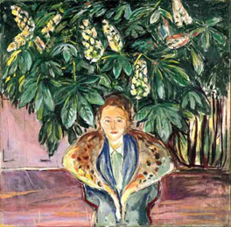
What is sense of coherence?
A global orientation that expresses the extent to which one has a pervasive, enduring though dynamic feeling of confidence that:
Stimuli derived from environment are structured, predictable, explicable
Resources are available to meet demands
Demand are challenges, worthy of investment and engagement

Slide 19
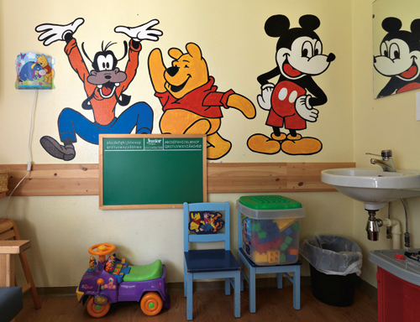
Sense of coherence
Comprehensibility: Extent to which one perceives stimuli as ordered, consistent, etc.
Manageability: Extent to which one perceives resources available as adequate to meet demands.
Meaningfulness: Extent to which one feels life makes sense, some demands worth investing in, challenges welcome

Slide 20
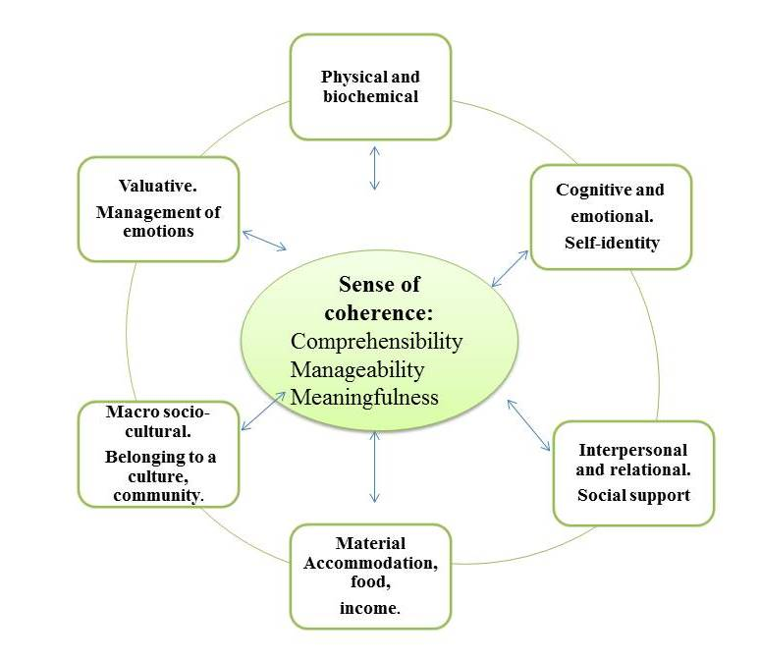

Slide 21
VINN - positive health outcomes in five countries – among them Russia (Mozhaysk, Mordovia, Ryazan, Belgorod, Perm, Chuvasia, Tomsk)
An increase in sense of coherence was associated with a significant decrease in emotional distress.
The results add new knowledge regarding a coherent theoretical foundation of a motivational program for women.
The ability of a program promoting health is important for women in correctional services.
http://www.emeraldinsight.com/doi/full/10.1108/IJPH-10-2014-0037

Slide 22
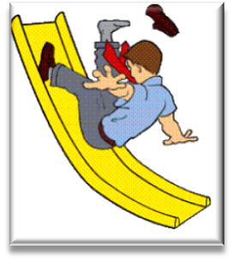
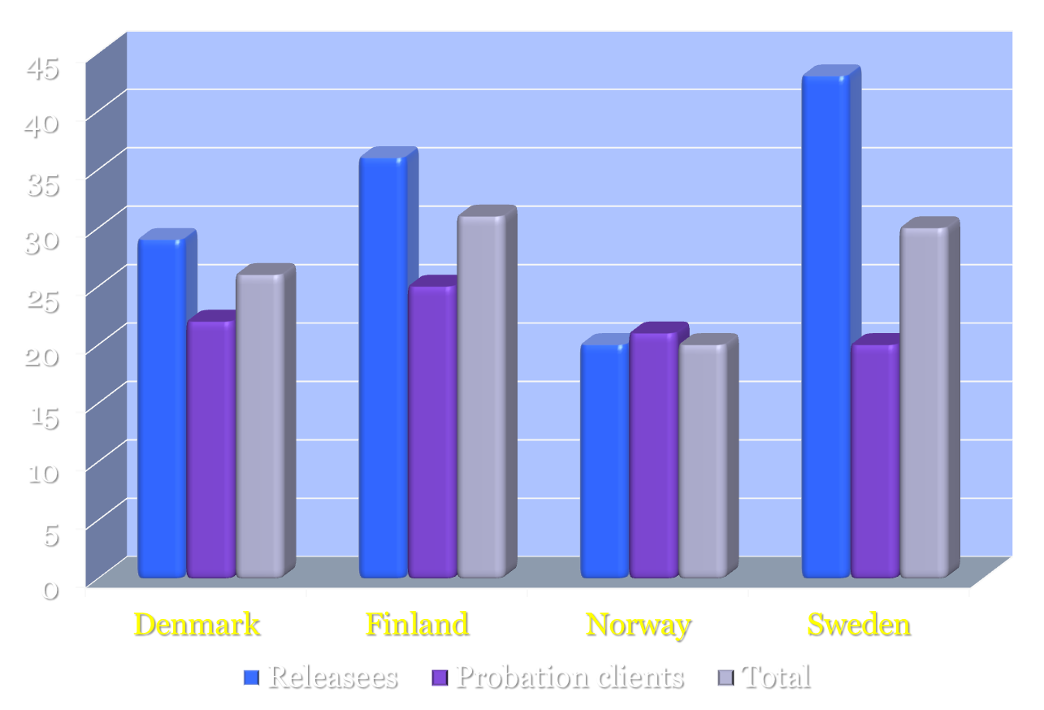
Recidivism
Source: ”Retur”, Nordic Research Group, 2010

Slide 23

Released - going home!

Slide 24
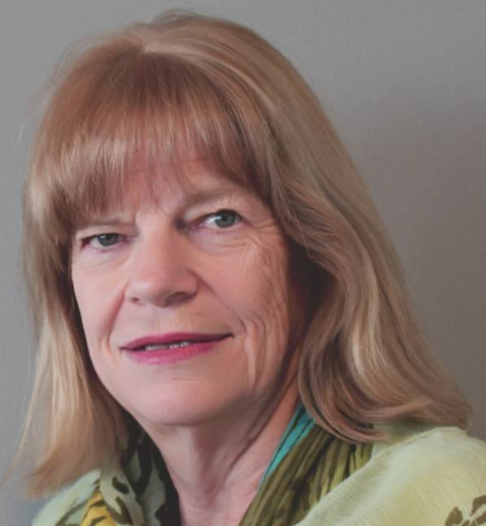
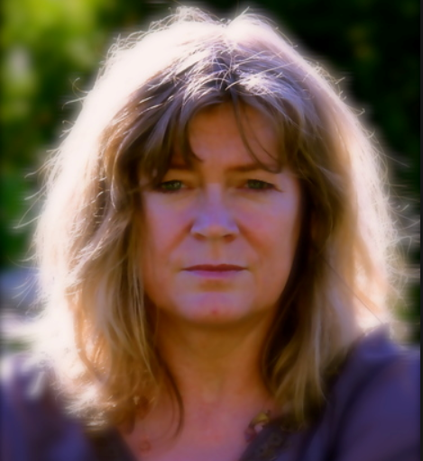
Thank you to Torunn Højdahl and Doris Bakken!

Slide 25

Thank you for your attention!

