Slide 1
SUPPORT AND RESOURCES CENTRE FOR THOSE AFFECTED BY HIV/AIDS
The circle of addiction and problems: women on streets. NGO DIA+LOGS experience in harm reduction work
Project “NGO as essential element of multi-actor partnerships for development of holistic prevention of drug and alcohol abuse among girls and women” Conference
“Effective approaches to prevent alcohol and drug abuse among women and to support dependent women”
20 November 2017 , St. Petersburg, Russia
Ruta Kaupe
Board Chairperson
NGO “DIA+LOGS”, Riga, Latvia

Slide 2
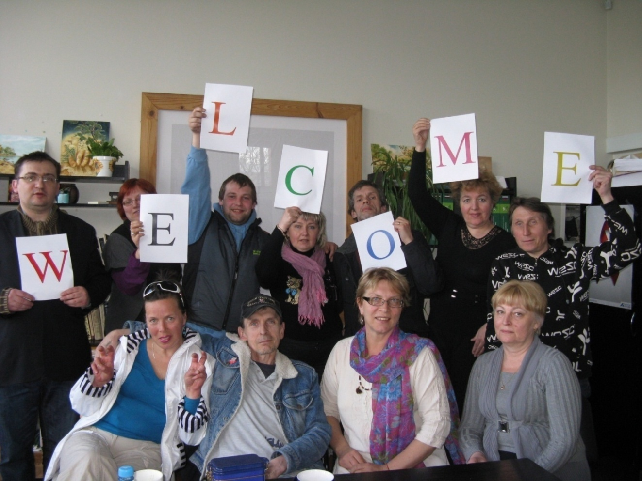
Do what you can, with what you have,
where you are!
(Theodore Roosevelt)

Slide 3
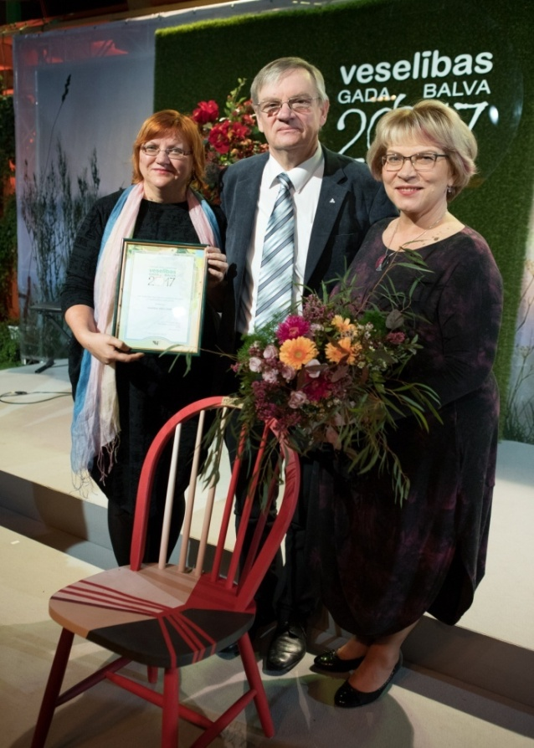
Agenda
What is NGO DIA+LOGS
Background situation: Latvia & EU
Woman on streets
What D+L do for addicted women:
Health – reducing harm
Psycho-social support
Advocacy
Health Award 2017
by Latvian Medical Association

Slide 4
NGO DIA+LOGS

Slide 5
What is DIA+LOGS?
NGO DIA+LOGS – support centre for those affected by HIV/AIDS
Mission: *Provide information, mental, psychological and social welfare support for HIV affected;
* Serve as information and resource center in HIV and addiction field.
Registered: May 15, 2002
Aim: Eliminate spread of HIV, provide support and services for HIV affected, friends, families & people from at-risk groups, educate, advocate and contribute to HIV/AIDS awareness
Financing for core program – Riga Municipality, CDPC:
Harm Reduction/HIV prevention program in Riga city
Other projects and activities – International organizations (EHRN-EC, ViiV HC PA, AHF, UNODC, Aksept u.c.), local donors

Slide 6
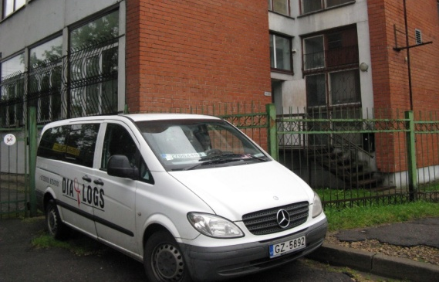
DIA+LOGS: fact-sheet
NGO DIA+LOGS – working in HIV/AIDS & HR field in Latvia for 15 years
Implemented: ~ 90 projects
Core program:
HarmRed – NS Exchange program
22 emplyees + 3 volunteers
Center, 2 mobile units, outreach
>75% of HarmRed work in LV
Budget: >190 000 EUR per year
Riga Municipality + Government + other International & local funders
Environment:
Clients: 27-32% are HIV+; ~30% women
30% of employees & 40% of D+L members - drug use experience;
In 2016 ~2300 unique clients, 7000 contacts,
in data base registered 6200 pers.

Slide 7
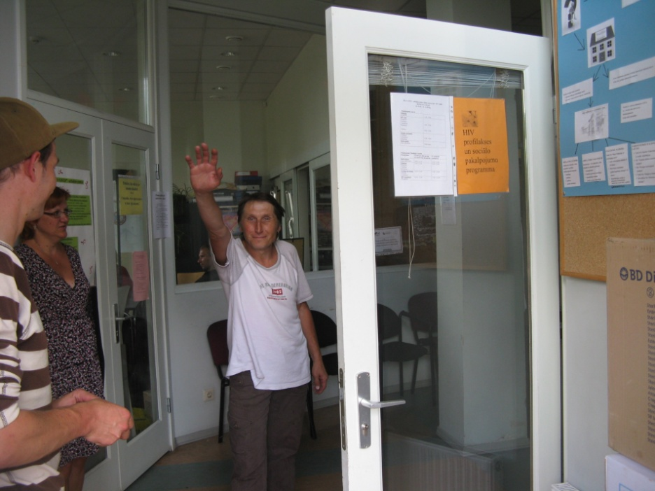
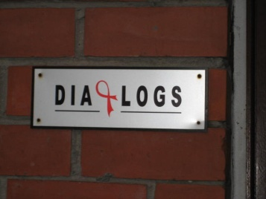
Key Community groups
HIV infected
AIDS patients
Intravenous drug users
Commercial sex workers
At-risk youth
....... and their families, partners & friends
Social & health care specialists working with affected community

Slide 8
Addicted women on streets

Slide 9
The circle of addiction and problems:

Slide 10
Women on streets
Research study – Papardes Zieds and LIC, 2012
Respondents: 117 prostitutes (18-48 y)
21,4% are HIV+
83% had injected drugs,
62% share syringes
23% started prostitutes work <18 y
Only 23% - in legally allowed places
15% have used condom during last sex-contact
Only 16% have visited dermatovenerologist in last year

Slide 11
Background situation:
Latvia & EU

Slide 12
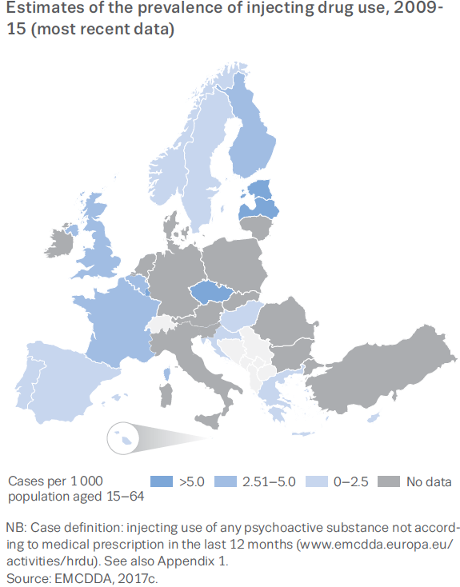
IDU prevalence
Prevalence in Latvia:
IDU – 25–32%
SW – 22%

Slide 13
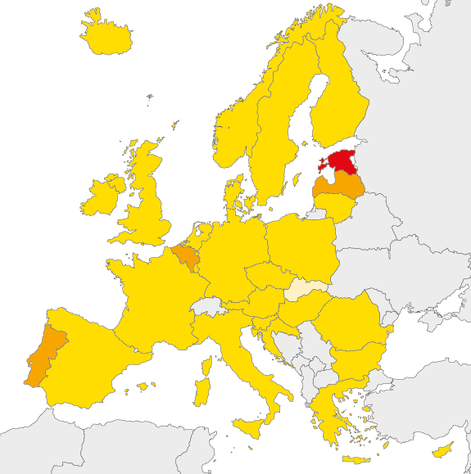
New HIV infection cases, EU/EEZ Latvia 2013: 2nd with 16,9 2017: 1st with 18,5
Per 100 000 inhabitants
< 2
2 to <10
10 to <20
24,6 - 17,4
> 20
16,9 – 18,5
Not available data
7,4 (LT)
10,0
10,4
New cases in Latvia:
Heterosexual -38%
Uknown – 37%
IDU -17%
Source: ECDC/WHO (2014). HIV/AIDS Surveillance in Europe, 2013
Data source: Center for disease Prevention and Control
Notes:
Igaunija, Latvija, Portugāle un Beļģija

Slide 14
Background LV: country situation
No specific structure for help for dependant women
Support and help could be found in
HIV prevention points,
Local municipalities’ social services,
Crisis centers, shelters
Addiction treatment (hospital) & OST program
In process elaboration
Program for SW Rehabilitation under Welfare Ministry
Prostitution Law under Interior Ministry

Slide 15
Latvia 7077 registered HIV+ ; 1836 – AIDS patients (2017.)
Municipalities
with HPP
Harm reduction, HIV prevention work:
19 HIV Prevention points in 16 municipalities - HPP network in Latvia
Data source: Center for disease Prevention and Control
PDU – 11 800; where 36% = 4 300 women
Concentrated HIV epidemic in male IDU’s community (WHO experts, 2011)
Prevalence PWID: HIV + 25%- 32% , hep C - ~82%;

Slide 16
DIA+LOGS: for addicted women

Slide 17
What D+L do for dependant women
Harm reduction program
Condoms distribution & Information
Psychologist and social workers’ consultations
Buddies’ peer support
Social support
Working groups for strategic documents
Drug policy IA project * National HIV plan
Rehabilitation program * Campaigning
HIV, STI tests & NSE
Support with vitamins, anti-flue vaccines
Prostitution law
Summer camps
Health
Psycho-
social
support
Advocacy

Slide 18
Health – reducing harm

Slide 19
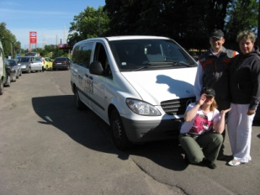
HR work model in Riga HIV prevention and psycho-social services for IDUs and their contactpersons in Riga city & region
Center
HIV tests
2 Mobile units
NS exchange
Info
Outreach
NS exchange
Psychologist’s counsultations
Social workers counsultations
Life with HIV
Psycho-Social support
Volunteers involvement
Info&education
Events&parties
Condoms
Condoms
HIV tests
Social worker or psychologist councelling
NS exchange
Condoms
Outreach workers

Slide 20
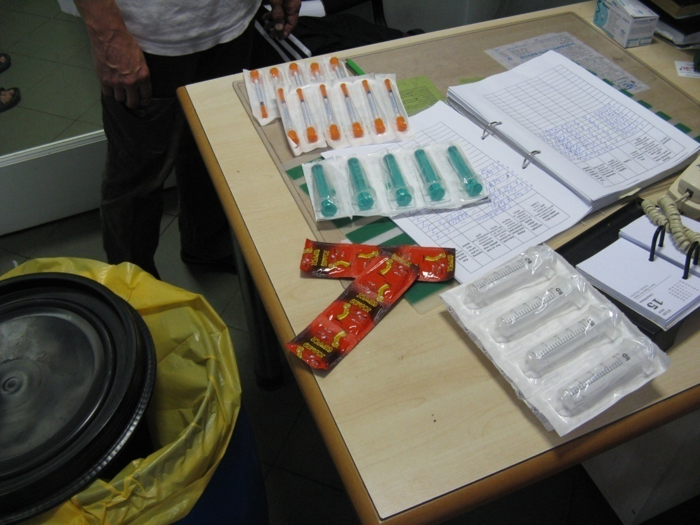
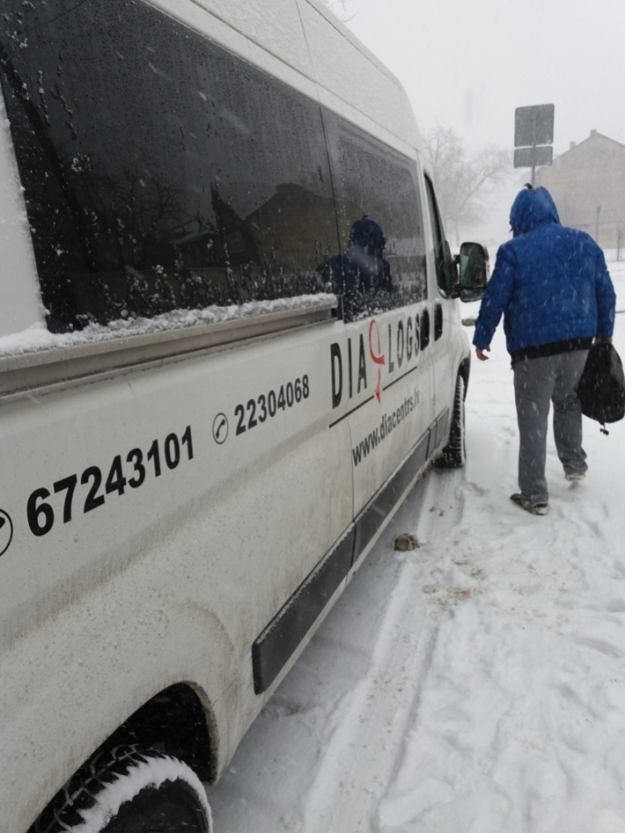

Slide 21
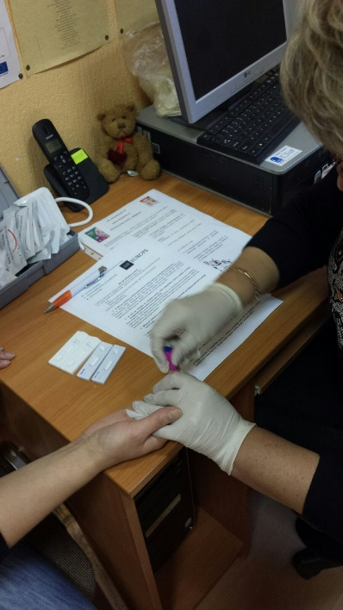
Provided services 2016
~75% of harm reduction work in Latvia:
Counselling ~ 3000 consultations
Psychological 500, Social - 1073, HIV - 1402
Tests – 1400 HIV + 3500 tests
HIV tests – 1402 - 6% HIV+, Syphilis , hep B&C - 3500
Needle & syringe exchange >530 000 pcs distributed
Distributed clean syringes ~ 530 000 pcs = 50 per person
Returned used syringes ~ 381 000 pcs
NSP in centre ~ 10-20 persons per day (4 000 contacts)
Outreach workers contacts ~18 000 contacts/year
Mobile HIV prevention unit ~250 rides per year
Distributed condoms 57 000 pcs
Contacted ~2 300 clients
300 h services per week

Slide 23
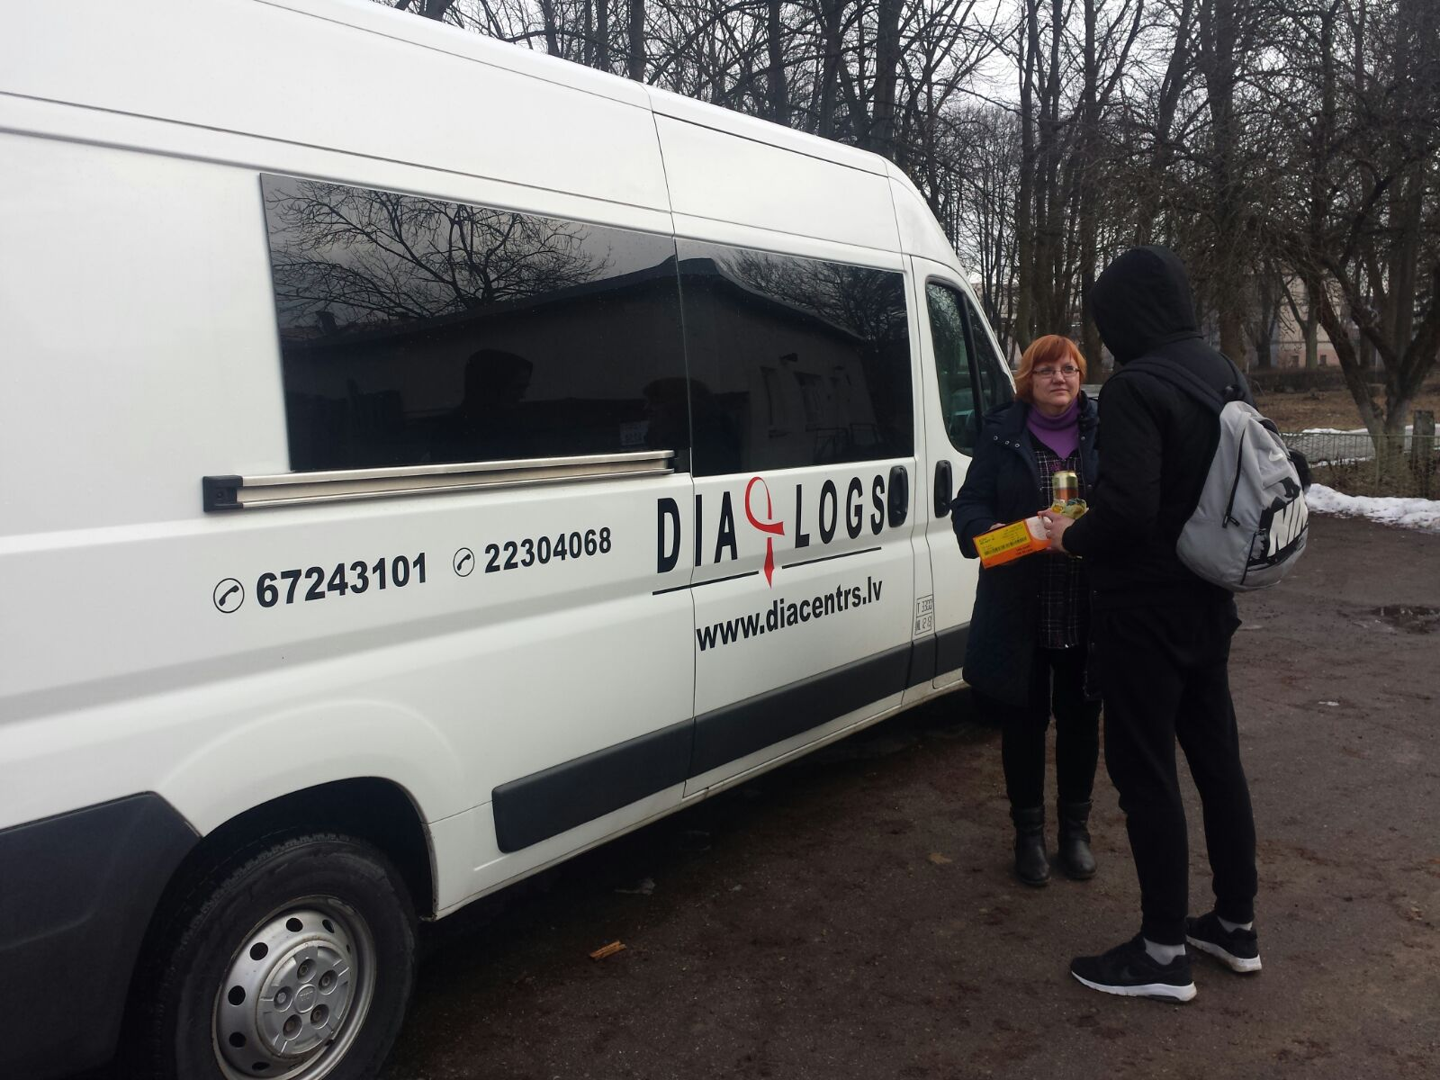
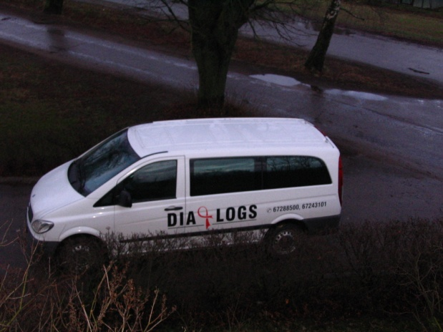
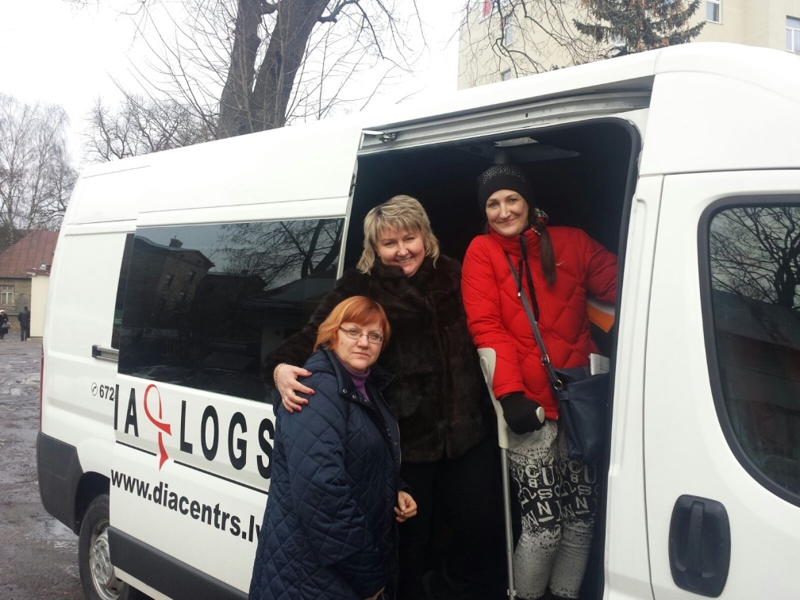
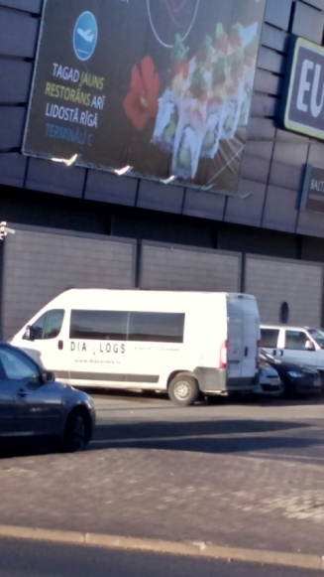

Slide 24
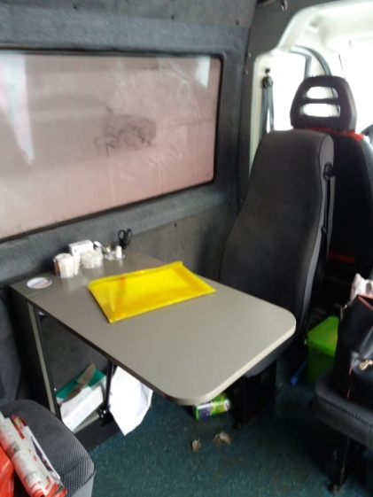
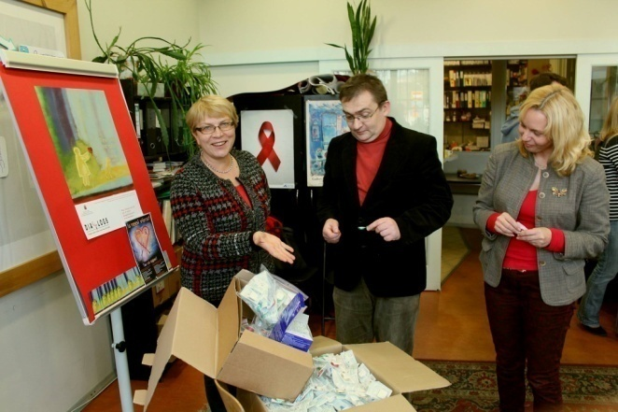
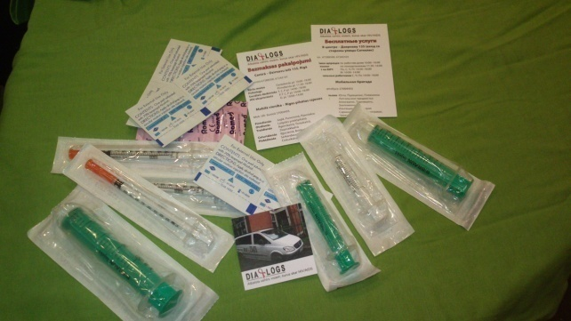
Other support for health care
Individual counselling – Life with HIV
First aid for wound care
Vitamins and anti-flu vaccines,
Contributions for clients health services
Educational lectures

Slide 25
Psycho-social support

Slide 26
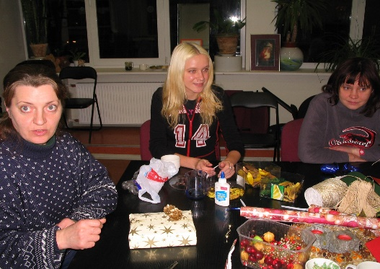
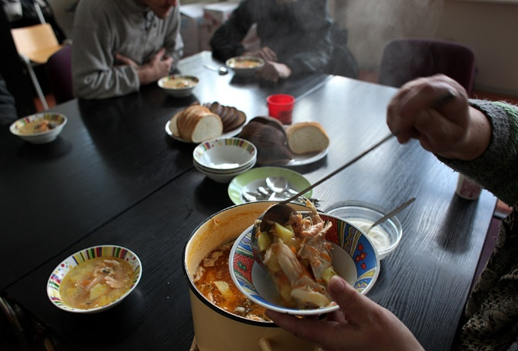
Psycho-social support
Psychologist and social workers consultations
Buddy peer movement
‘Open doors’ regular Thursdays with hot soup
Social support (food packages, clothes)
Support group
Social info for community
Summer camps for families
Common parties, events for community

Slide 27
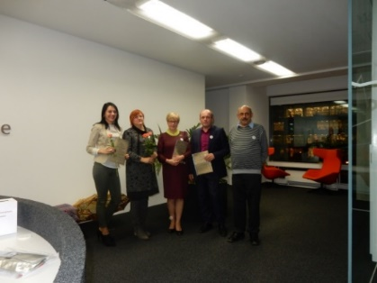
Buddy peer movement
Buddy : friend & peer & helper
in challenging situations for HIV+ people
Trained 23 Buddies
Provided help to ~35 HIV+persons
195 direct peer meeting times
225 persons consulted by :
180 phone conversations
121 e-mail letters
We provide support in Riga, Ogre, Kekava, Kuldiga, Tukums

Slide 28
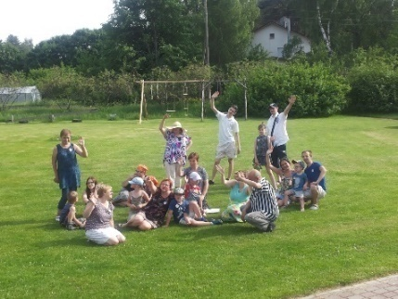
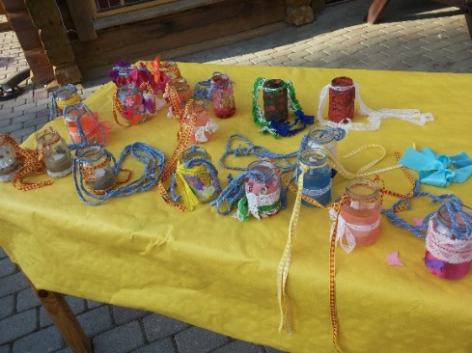
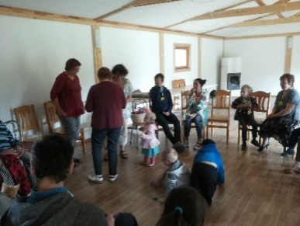
Camp for families
The only camp for HIV+ families with children
– 3 days in summer near sea!
Participated 20 people
Creative & educational activities: Mandalas, tales, clouds, Indian decorations, lights, butterflies, dream catchers Educational lectures on HIV
Much Thanks and wish to meet next summer!

Slide 29
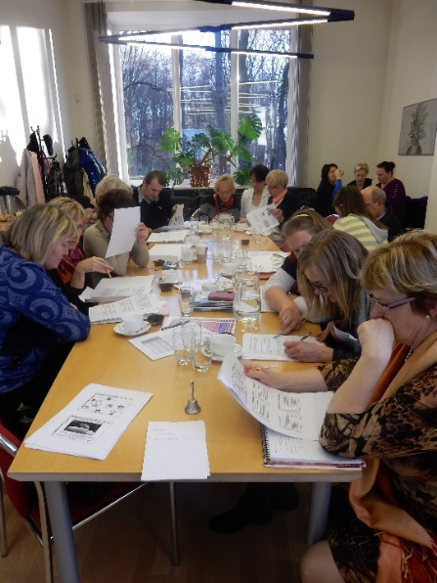
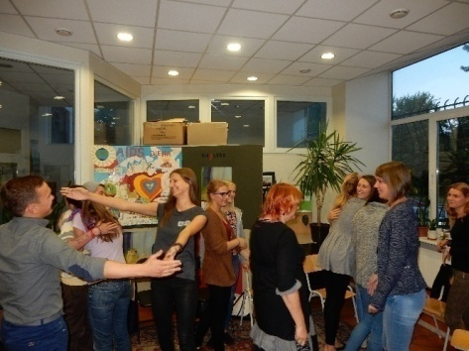
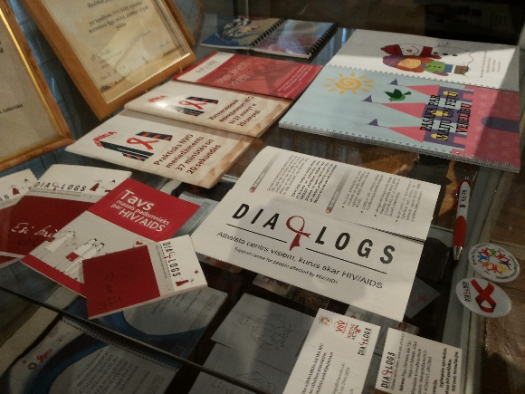
Education, information
Training center «Izaugsme»
www.apmacibasizaugsme.lv
Lectures:
For target groups,
In shelters, crisis centers
In schools
Booklets,
Leaflets,
Newsletter

Slide 30
Advocacy

Slide 31
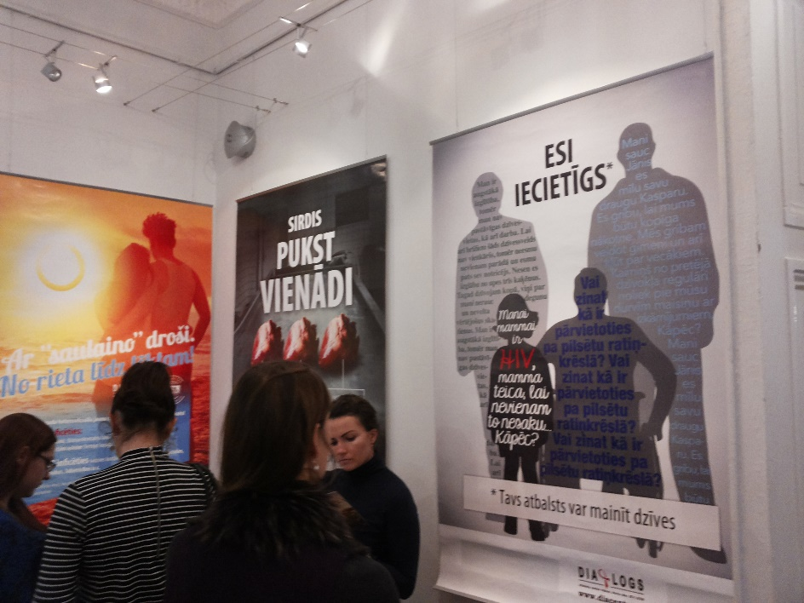
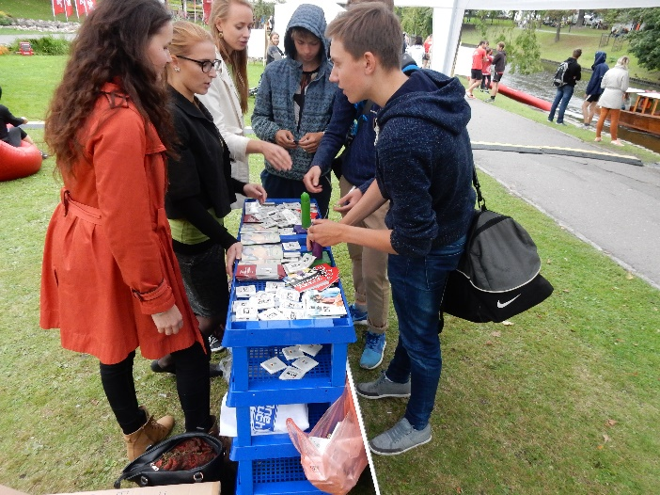
Reducing stigma
Friendly atttitude
Buddies’ support
Campaigns on tolerance
Work with youth

Slide 32
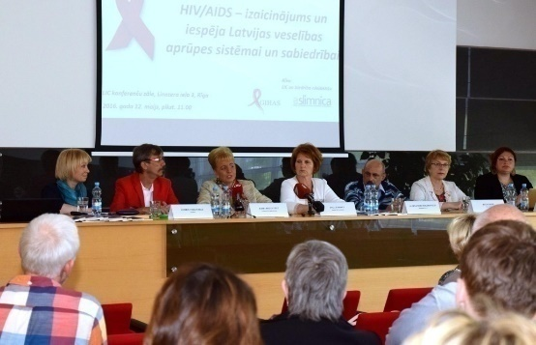
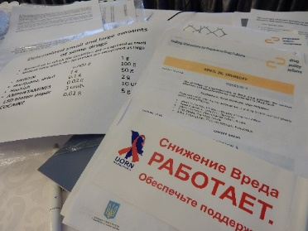
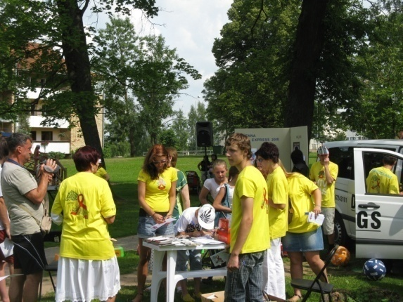
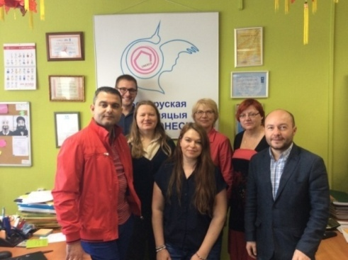
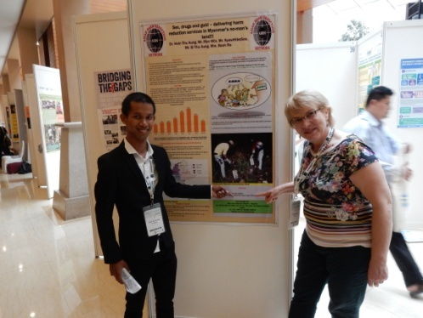
Advocacy work
Involvement in ministries’ working groups elaborating policies & laws
Campaigning
Work with media
International cooperation

Slide 33
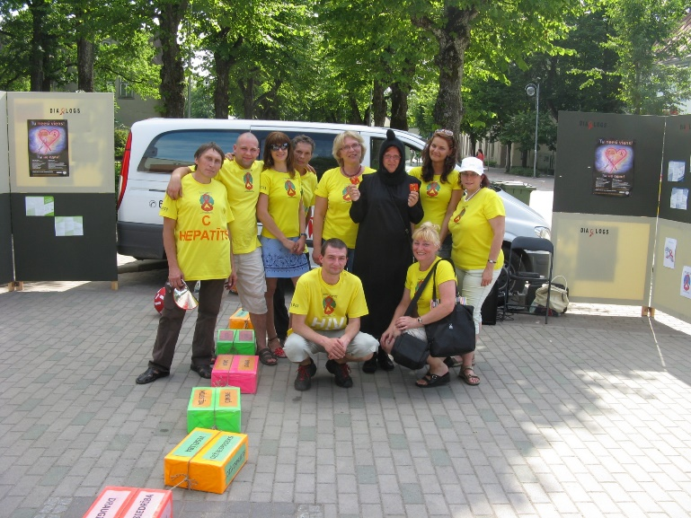
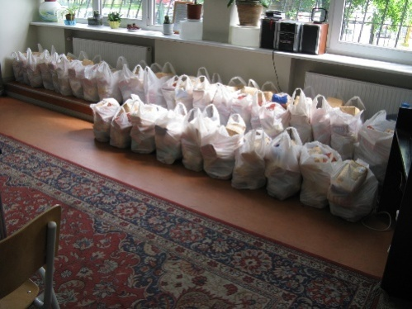
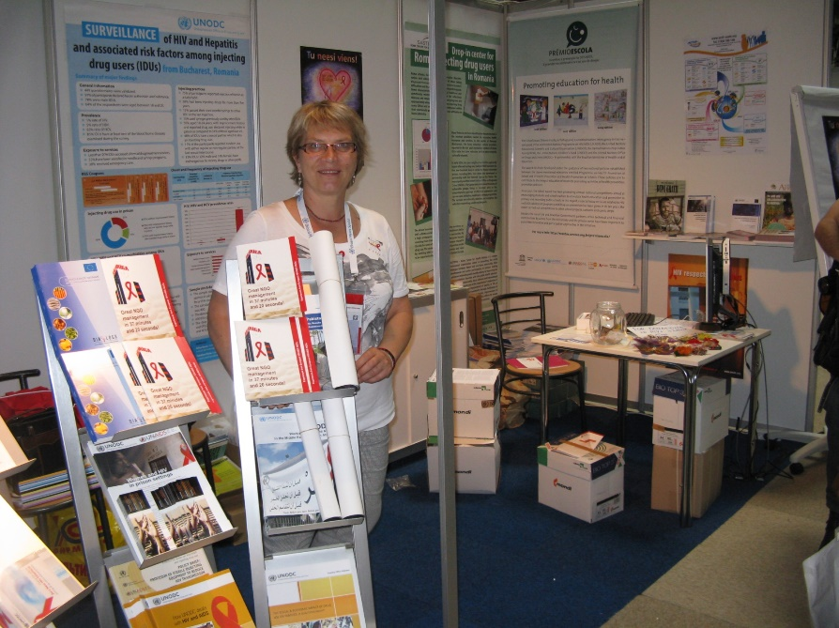
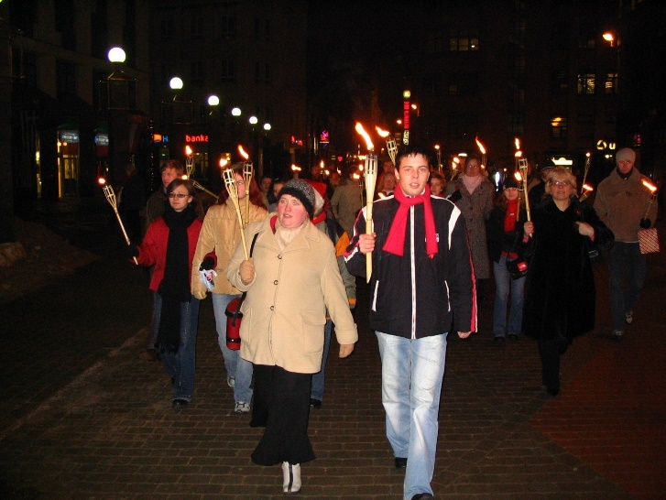
Campaigning

Slide 34
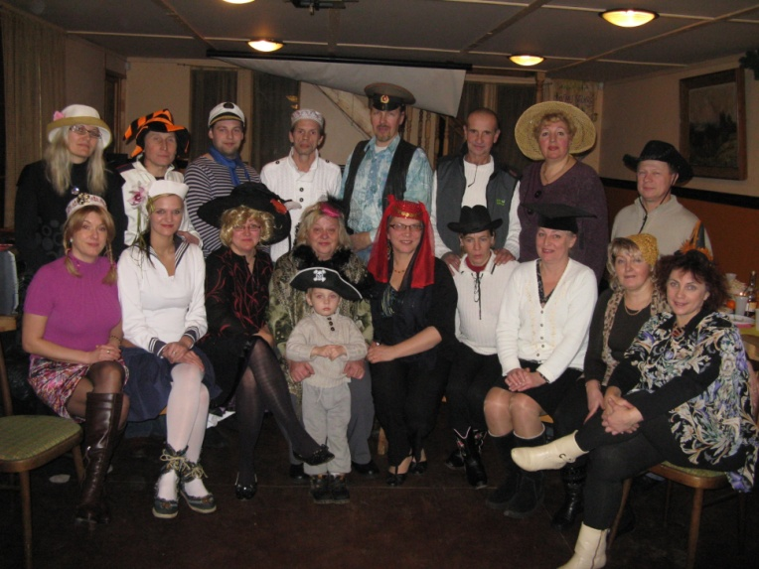
YOU ARE WELCOME FOR COOPERATION dialogs@diacentrs.lv Ms. Ruta Kaupe – Board Chair (ph +371 67243101); e-mail: dialogs@diacentrs.lv Dzirnavu street 135, Riga, Latvia, LV-1050 home page: www.diacentrs.lv

