Slide 1
”BellaNet International –from basement floor to
EU:s Top Ten Story”
Britt Fredenman
Project Manager at WOCAD/Women´s Organisations Committee on Alcohol and Drug Issues.
Member of Management Committee at ICAA/ International Council on Alcohol and Addictions.
April 2017
Sankt Petersburg, Russian Federation

Slide 2
We thought in the beginning of 1990´s that:
girls should meet to discuss issues relating to lifestyle, identity, courage and self-esteem.
girls should be given the opportunity to realize their potential,develop their decision-making capacity and train preventive action.
girls may need help to strenghten their identity and take pride in themselves as girls.
Girls need training to identify and reject violations of their rights.
It is stimulating to work with girl groups.

Slide 3
History of Rubble and Roses
WOCAD has educated about 7000 girl group leaders in Sweden since 1994, in all of Swedens 21 counties.
WOCAD has educated in other countries, Iceland, Romania, Belarus, Finland…

Slide 4
Different reasons for focusing on girls
Meeting at the crossroads
Reaching out to all teenage girls
Various studies of risk behavior among young girls
Girls’ leisure activities
Quiet girls
Drunk and aggressive girls
Increased number of girls at risk

Slide 5
How do we reach teenage girls?
Early alcohol debut and binge drinking, mood altering pills
Bella –Rubble & Roses 2
Material for leaders of girl groups
Interactive methods and techniques designed to influence attitudes and change behavioural patterns
Reflection

Slide 6
Why girl groups are drug preventive
Research show:
the importance of developing independence and self esteem as young girls
the need and ability of setting boundaries and healthy limits
changes in alcohol and drug behavior after testing solutions to
everyday conflict situations - life coping skills
the importance of dealing with stress
3 out of 4 girls change their drinking habits after attending a girl group

Slide 7
Twelve current themes
Self-confidence-independence
Friendship
Different cultures
Boys and girls-equality/inequality
Harrasment and insult
Our bodies
Violence and bullying
Life, death and religious faith
Tobacco, alcohol and party drugs
Love, sex and relationships
The family
The future

Slide 8
Interactive methods for influencing attitudes, self-confidence and group development
1. Value clarification exercises
- Reflect and take stand
- Express their opinions
- Justify their standpoints
- Be listened to and listen to others
- Reflect and revise attitudes
2. Reflection
- A new element
- The effects of exercises on earlier held standpoints
- No debate
- No hierarchy
3. Forum Play
- Drama and theater often appeal to girls
- Provides healthy training in taking action
- Quiet girls are given the opportunity to play expressive roles
- Developes communication abilities and strengthens self-confidence

Slide 9
Examples of value clarification exercises
The hot seat – standing up for your beliefs
Stand-on-a-line – allows you to polarise issues in a dramatic way
Dilemma/4-corner-exercise – based on a question or problem on which the participants must formulate an opinion
Unfinished sentences – the leader formulates unfinished sentences and participants complete the sentences spontaneously with whatever comes to mind

Slide 10
What did the girls think?
A sense of sharing
Greater tolerance
Understanding – empathy
Increased self-confidence

Slide 11
What did the girl group leaders think?
The focus on girls is important
Their own need of :
- support
- supervision
- sharing experiences
- drug education
- training and developing group leader skills
WOCAD started a project – a National Network For Girl Group Leaders – BellaNet on Internet
WOCAD employed a project leader in November 2005, Britt Fredenman

Slide 12
Network for girl group leaders - BellaNet
National Network for girl group leaders
Present project, since 2005
Rooted in all 21 counties in Sweden and since 2009 also international members
Purpose: to strengthen, stimulate and develope methods for working with drug preventive girl groups

Slide 13
BellaNet International has members and girl group leaders in:
Romania
Brazil
Iceland
Ecuador
Finland
Belarus
Denmark
USA
Norway
Netherlands
Portugal
Latvia
Lithuania

Slide 14
WOCAD Commitment
Opening up WOCAD’s national network for girl group leaders in Sweden (www.bellanet.se) to those in EU interested in gender specific drug prevention.
The international network will raise awareness of drug-related issues and aim at preventing the use of illegal drugs among teenage girls in all EU countries.
The Swedish network will support new international members and together develop and exchange methods.
www.bellanet.se will be open 24 hours a day from 26 June 2009.
WOCAD will introduce two persons from each EU-country in methods of starting drug preventive girl groups with the ”Bella-method”:
Girls meet in groups to perform values clarification and forum plays around various life topics. After a period of regular meetings their self-esteem grows and also their awareness of their own power.

Slide 15
EAD – European Action
on Drugs
WOCAD’s drug preventative work with girls and young women in focus, BellaNet, was recognized 2009 by the EU Commission as an EAD-activity (European Action on Drugs).
The EAD objective is to enhance information and awareneness levels about the risks of drug use among youth.
EAD embraces NGOs, local and national bodies, individuals, schools, universitites, companies etc.
www.action-drugs.eu

Slide 16
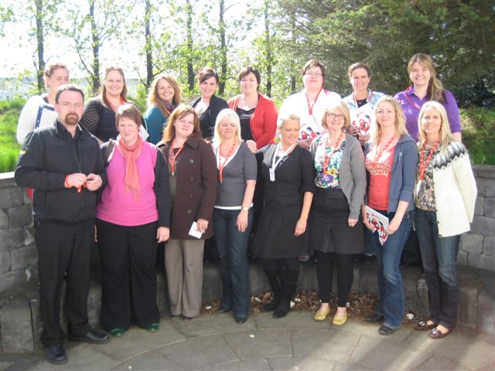
Iceland 2009

Slide 17
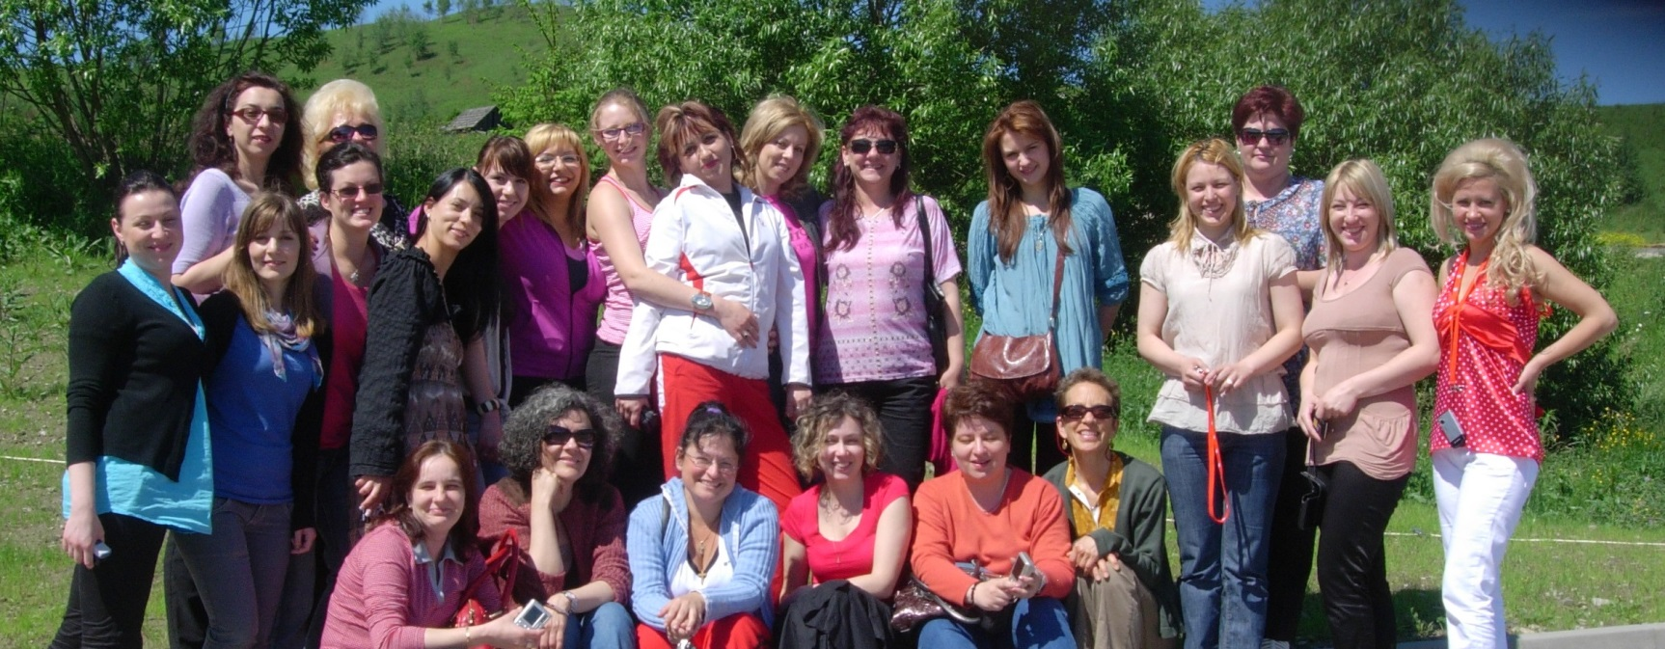
Romania 2010

Slide 18
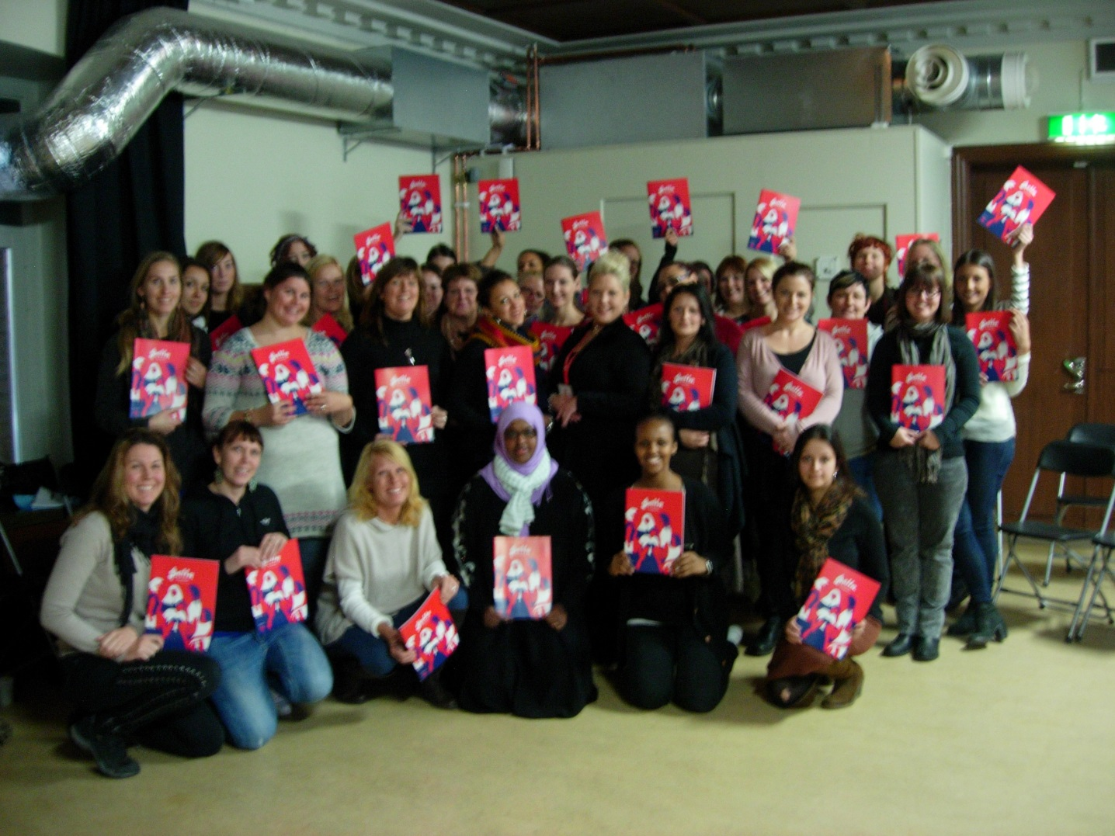
Sweden 2011

Slide 19
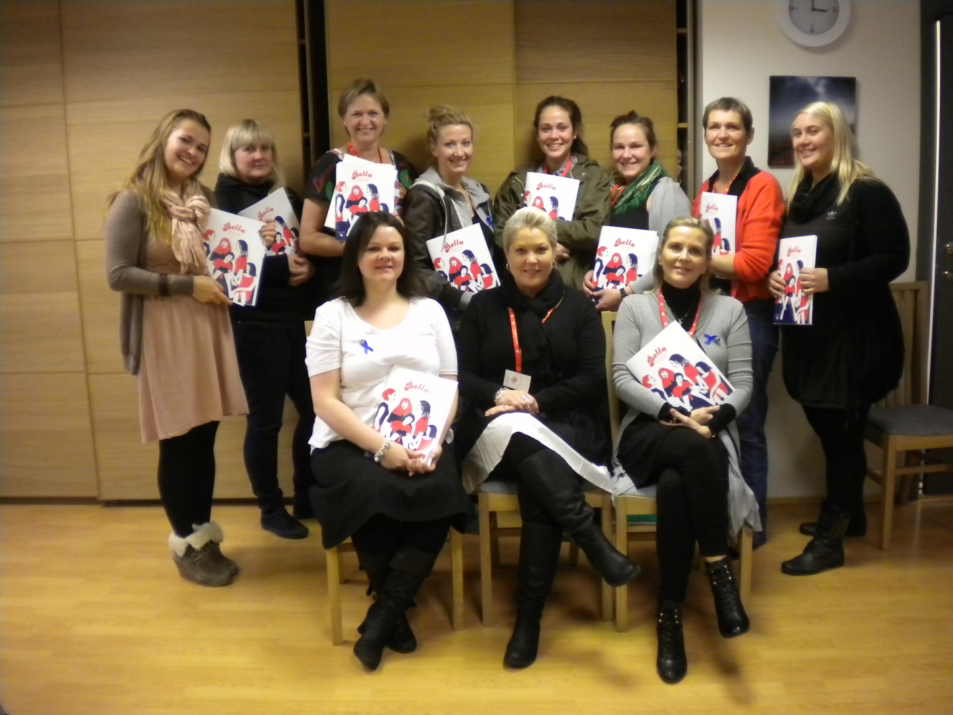
Iceland 2012

Slide 20
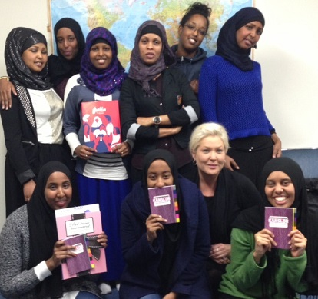
Sweden 2013

Slide 21
Finland 2013

Slide 22
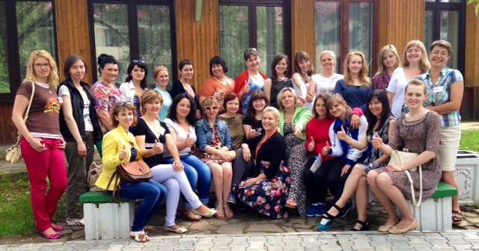
Belarus 2014

Slide 23
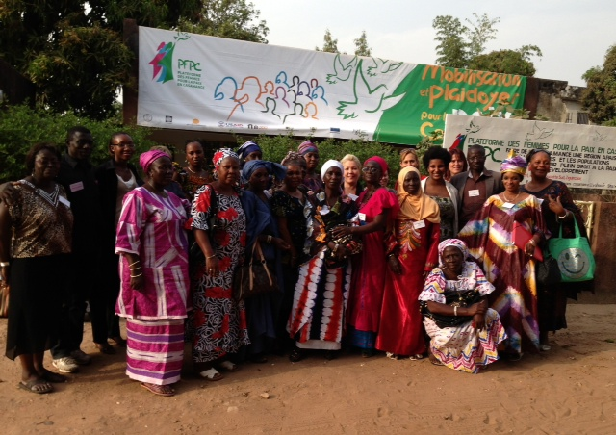
Senegal 2014

Slide 24
Latvia and Lithuania 2015

Slide 25
Sweden 2015

Slide 26
Sweden 2016

Slide 27
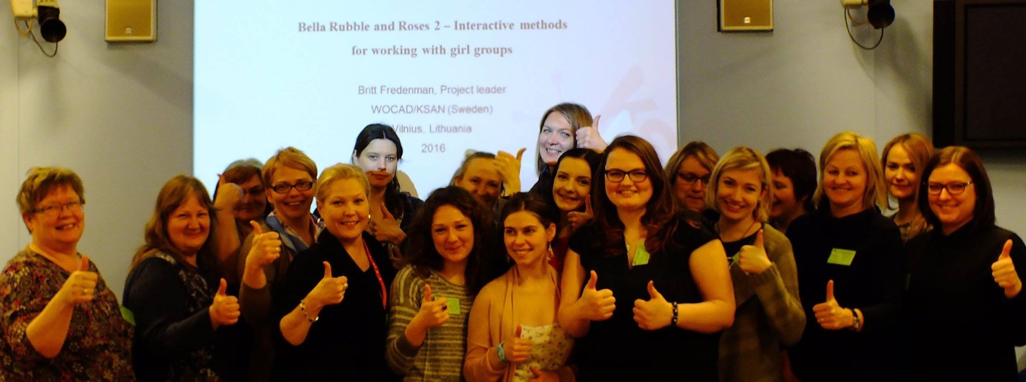
Lithuania 2016

Slide 28
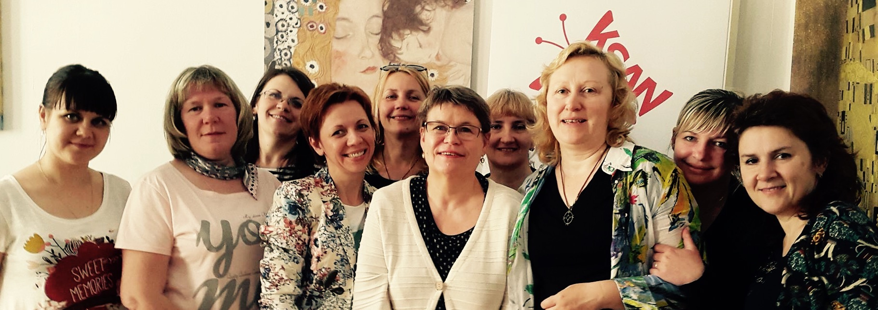
Network meeting in Sweden 2016, with BellaNet members from Finland and Belarus

Slide 29
WOCAD’s material translations
WOCAD’s method material
”Bella Rubble and Roses 2”
(KSAN/K.Byréus,2001,2006)
has been translated into
English, Romanian, Russian and
Finnish

Slide 30
Examples of newly generated projects where WOCAD’s method is used:
A) Project Equal Opportunities for an Inclusive Community targeting 500 Roma women from
rural communities. Bella-method is being used as a stepping stone for promoting non
discriminatory factors and alcohol preventive behaviour in 3 girl groups among 39 young Roma
women aged between 16 and 30.
B) Project Addiction between Necessity and Spirit, focusing on teenage girls’ risk behaviour,
aged between 16 and 18, who have been abandoned by parents or are orphans.
C) Joint project of Romanian and Moldavian girls “Younger club”, aimed at developing self
esteem skills and preventive behaviour among young women between 18 and 24. The target
group consists of slightly mentally disabled girls and those infected with AIDS and HIV. There
are 25 girls involved in the project so far.
D) Association of Suceava teachers together with 5 organisations from Belgium, Spain, GB,
Turkey, Greece and Denmark are using the method to develop communication skills
concerning prevention in discussions with children among teachers and parents from rural area
communities. The target group comprise almost 1000 women. By now 2 groups of 20 mothers
and women teachers are formed.
E) Project Women: beggary and poorness – focused on informing about how to prevent
violence against women and preclude alcohol and drug consumption. The project is being
implemented in the area of wine production. Alcoholism is a great problem for many there,
including women. The project embraces around 100 women and girls.

Slide 31
New challenges when working with gender specific drug prevention
WOCAD’s work with gender specific drug prevention is always evolving as new challenges face those who work with prevention.
WOCAD continually informs BellaNet International with updated news about topics related to girls and drug prevention.
WOCAD works with different projects, e.g. about Marketing of tobacco and alcohol, and Girls and pills – BellaNet International receives information about WOCAD’s projects.

Slide 32
Targeted marketing of tobacco and alcohol to young women
Increasing number of Swedish teenage girls are smoking
- Aggressive marketing of tobacco targeted at young women
WOCAD has 38 member organisations and gathers 340 000 women. WOCAD is mobilising this huge network for tobacco-preventive work!
Seminars, newsletters, film, new material for girl groups.

Slide 33
The gender perspective of the alcohol industry
Carlsberg UK has launched a
low calorie, low alcohol drink
for women.
David Scott, Carlsberg UK, said:
“The drinks industry has largely
ignored female consumers in the
on-trade for a long time, which is
criminal.”

Slide 34
Bag-in-bag
The producer describes this wine as:
”…the wine with the female touch…”
”… from practical to elegant…”

Slide 35
Fitness doping – Legal or illegal highs
”Barbie-drugs”- young women using
pills to loose weight and trying to
look a certain way to fit a barbie
doll image of sexiness and beauty.
Clenbuterol is often referred to as
the ”size-zero-pill”.
Many of these pills have serious
side effects, e.g. high blood
pressure, constipation, anxiety, etc.
Pictures from: http://se.clenbuteroldirect.com/

Slide 36
Conclusions
Targeting teenage girls is an ongoing project
Drug preventive education an ongoing project
Inspiration to focus on health, happiness and sisterhood
Training girl group leaders as leaders and role models
BellaNet: 24 hour access to building drug preventive capacity, both national and international
Approximately 40 million European teenage girls are
waiting for us!

Slide 37
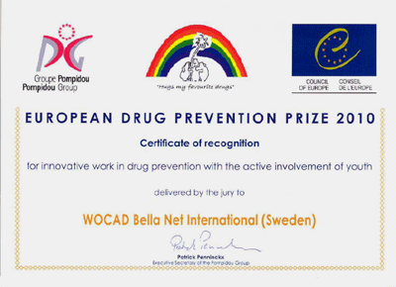
Recognition and awards for WOCAD/BellaNet
In 2009 the internet forum www.bellanet.se
was validated by the EU-commission as a useful
activity in EAD /European Action on Drugs.
In 2010 BellaNet International received
a Certificate of recognition, from the
Council of Europe Pompidou Group,
for innovative drug preventive work.
In 2013 WOCAD’s contribution to
European Action on Drugs has been selected
as one of the Top ten submissions in the
EU for drug prevention.
In November 2015 WOCAD was awarded the Swedish CAN-prize
for “Best NGO 2015”.The prize was given to WOCAD for its
long-standing work with strengthening health and preventing drug
abuse among girls and women

Slide 38
WOCAD Winner of European Business Awards CV Magazine 2017 Non-Profit Organization Management

Slide 39
20 years of gender specific
drug prevention – The interactive Bella method

Slide 40
Thank you for your attention!
Britt Fredenman,
britt.fredenman@ksan.se
+46 703 98 10 41
info@ksan.se
+ 46 8 101051
www.ksan.se
WOCAD/KSAN
Östermalmsgatan 33
S-114 26 Stockholm
Sweden

